Slide 2
The webinar will begin shortly…

Slide 3
Digital Transformation
How Alemba Service Manager has helped local authorities deliver results, cost-effectively.

Slide 4
Agenda
Introduction (5mins)
Customer Presentation: Torfaen (15 mins)
Customer Presentation: Liverpool City Council (15 mins)
Demo – Alemba Service Manager Portal & Workflow (7.5 mins)
Other Departmental Use Cases (7.5 mins)
GMP account management automation
Haringey Council Shared Service Centre
HSCNI Counter Fraud Initiative
Q&A – 10 mins
Notes:
What is the use? What did they do before? How did we help? Stats/time saved

Slide 5
Introduction
Laurence Scott-Mackay, Strategic Account Manager, Alemba

Slide 6
Accelerating Request Building – The Core of Digital Transformation
Executives
BUSINESS
DASHBOARDS
APPROVALS &
NOTIFICATIONS
INITIATE REQUEST
PROCESS REQUEST
REQUEST FULFILLMENT
End User
Requester
Analyst
SERVICE CATALOG
All Services in the Enterprise
SERVICE RECORD
> HELP
> ORDER
> CHANGE
> INFO
SERVICE-ORIENTED
WORKFLOW
REPORTING
& ANALYTICS
SEARCH KNOWLEDGE
COLLABORATE
KPI
DASHBOARDS
APPROVALS &
NOTIFICATIONS

Slide 7
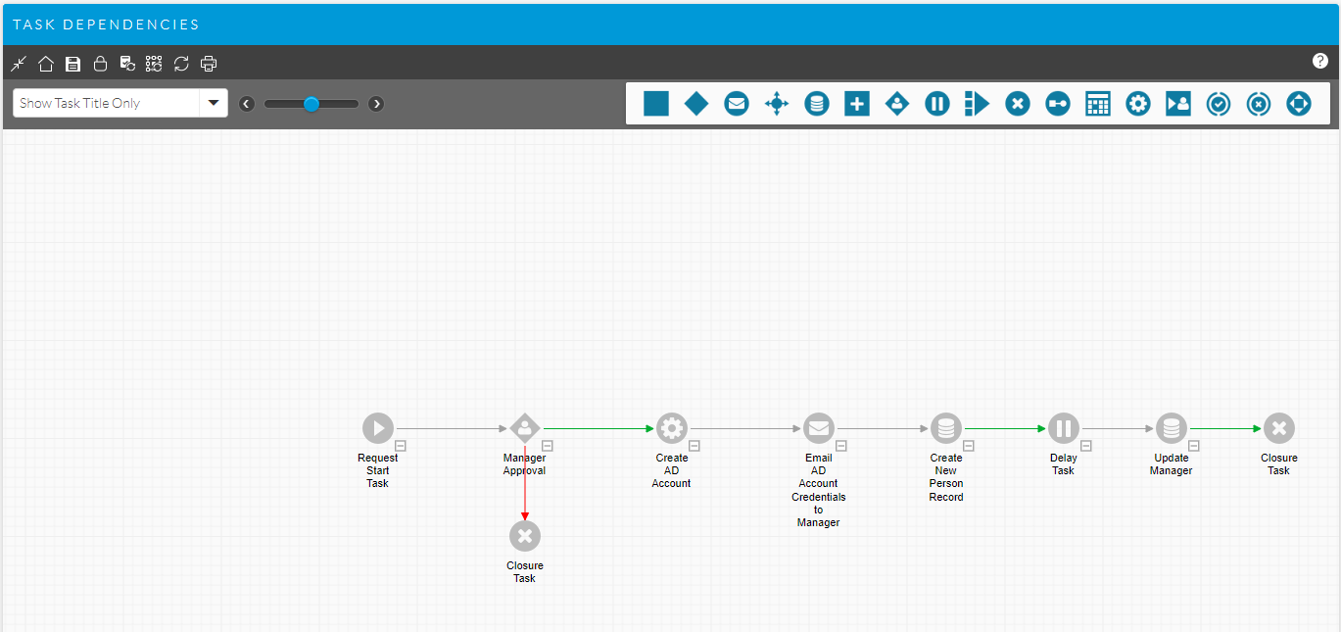
Zero-code custom app builder
Human approval
Flow can branch differently for approve or reject
Large palette of tasks for different kinds of logic control
Simply drag and drop onto the canvas to use
Linkage also works by click and drag between tasks
Self-contained app
Graphical logic flow
Templated to allow re-use
System task (robotic)
Executed automatically
as soon as it becomes active

Slide 8









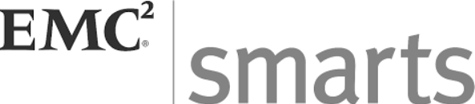























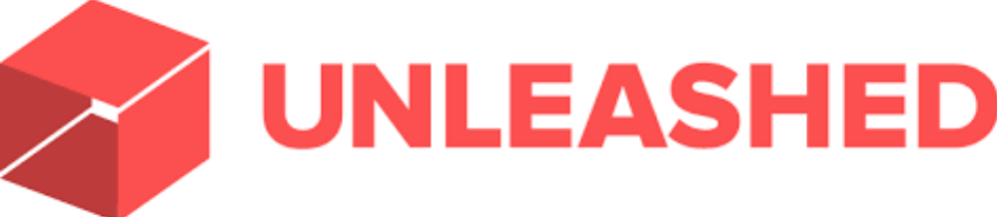











Extensive catalogue of snap-in connectors
CMDB
Collaboration
Communication
Workflow
Telephone
Event Management
Cloud Management
Project Management
Service Desk
Data Capture

Slide 9
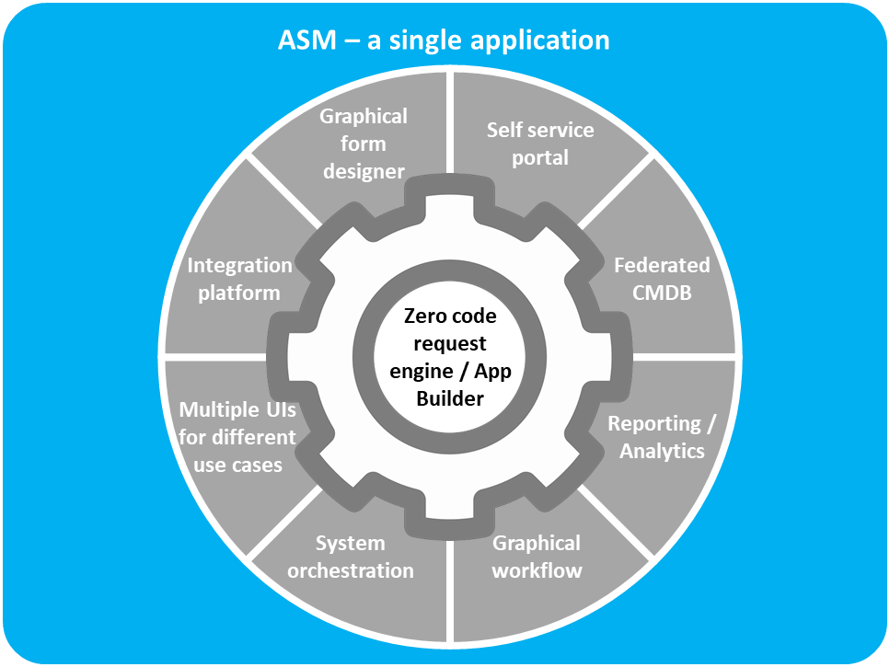
ASM: key use cases
Single application – multiple uses
ITSM
Event Management
Service Catalogue Management
Change Management
Service Level Management
Strategy Generation
Financial Management
Service Desk
Incident Management
Problem Management
Availability Management
IT Ops Management
Release & Deployment Management
IT Service Continuity Management
Supplier & Contract Management
Information Security Management
Governance & Compliance
Service Validation & Testing
Knowledge Management
Service Portfolio Management
Capacity Management
Known Error
Digital Transformation
Case Management
BPM
Cloud Management
Automated Request Fulfilment
RPA
MSPs

Slide 10
Enterprise Service Management - Data Structure
IT
HR
Facilities
Procurement
Central Administration
ASM partitioning functionality provides the required data separation between service support groups while still allowing a single administration team to support all service support groups and customers.
Accelerating your digital transformation

Slide 11
Case Study: Torfaen SRS
Matt Lewis, COO, SRS

Slide 12
Case Study: Liverpool City Council
Brendan Lavelle, Programme Manager, Liverpool City Council

Slide 13

Service Transformation in ICT

Slide 14
ABOUT LIVERPOOL CITY COUNCIL
Liverpool City Council is the governing body for the city of Liverpool in Merseyside, England.
Population 480,000.
30 Council Wards.

Slide 15
ICT Support
Over 5000 technology users (including schools).
230 support staff across several service areas.

Slide 16
Challenges
Old systems.
Little or no integration.
Duplicated Processes.
No real flexibility to develop.
Customer contact choices limited.

Slide 17
Tool Selection Process
Alemba’s vFire selected through Local Government Framework.
Contract negotiated and completed Jan 2016.
3 year contract (+1+1).
On-Premise hosting.

Slide 18
Implementation
Alemba consultant assigned.
Dedicated team of ‘work-stream leaders’.
Lots of workshops.
Used Rapid Start but plenty of development.
No partitioning.
Big focus on Customer Portal (‘UserHub’).
Project broken down into two phases.

Slide 19
Phase 1 Go-live – Nov 2016
Incidents.
Problem Management.
Requests/UserHub.
Configuration and Asset Management.
Event Management.
SCCM integration (desktop).
AD / Oracle HR integration (user details).

Slide 20
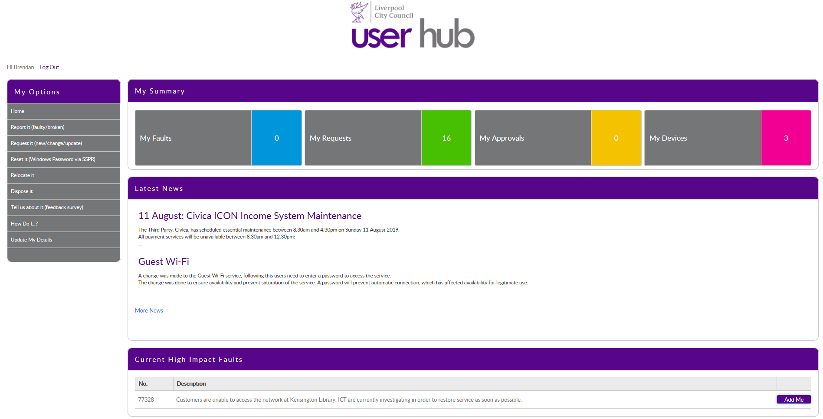

Slide 21

Approval workflow for over 120 requests
Request Start Task
Network Triage Task (CeaseP…
Check Level of Approval Requ…
Access to Data Approval
Data Access Activation
Divisional Manager Appr…
Check If Chargeable
SLM Start Task
Executive Director Appr…
Implement Service Request
Closure Task
Line Manager Approval
LM Activation
Divisional Manager Appr…
Executive Director Appr…
Create Request Task
ATD Reject Activation Task
Service Request Approvers Ap…
SRA Activation
Divisional Manager Email
LM Rejection Activation Task
Closure Task
Check level of approval email…
SRA Rejected Activation Task
Divisional Manager Email
Access to Data Approver Email
Line Manager Approval
Service Request Approver
Email Originator Failure
Closure Task

Slide 22
Example Requests
New User Account.
Install Software.
Connect a Device
Block/Unblock Website.
New Website Development.
Advice and Guidance.
Report Lost Device.
Email Services.
Printing Services.
Remote Access Services.
Internal (ICT) Process Requests (e.g. overtime authorisation).

Slide 23
Phase 2
Business Change (Projects).
Change and Release Management.
Mobile App.
Further enhancements to UserHub Requests.
Knowledge Management.

Slide 24

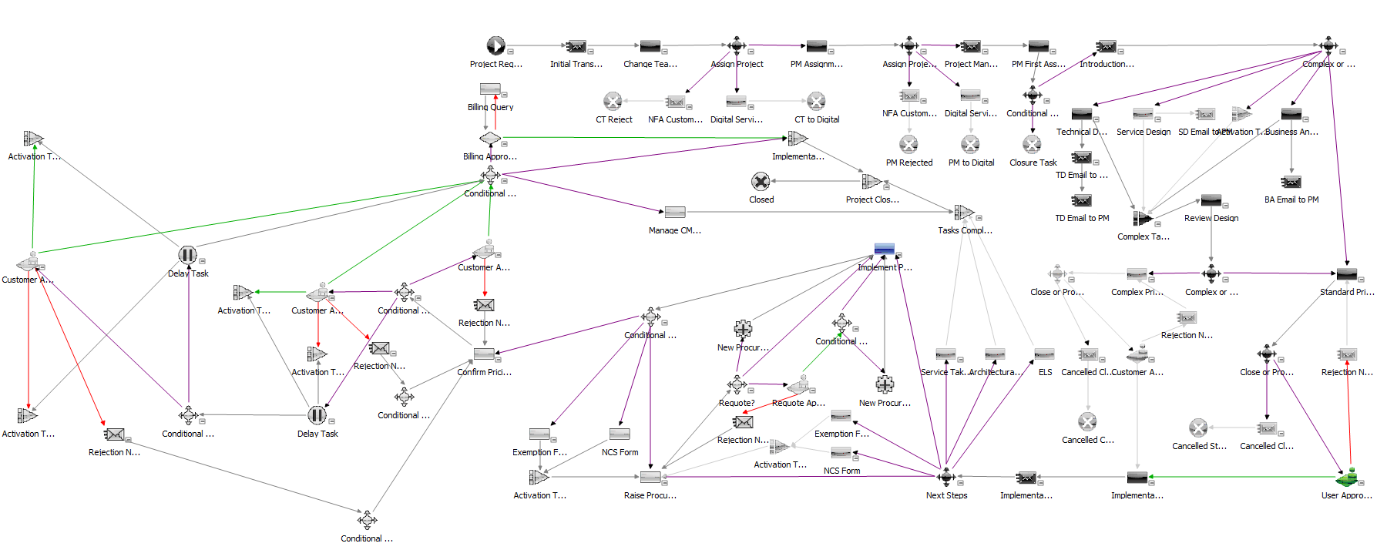
Business Change / Project Management Workflow

Slide 25
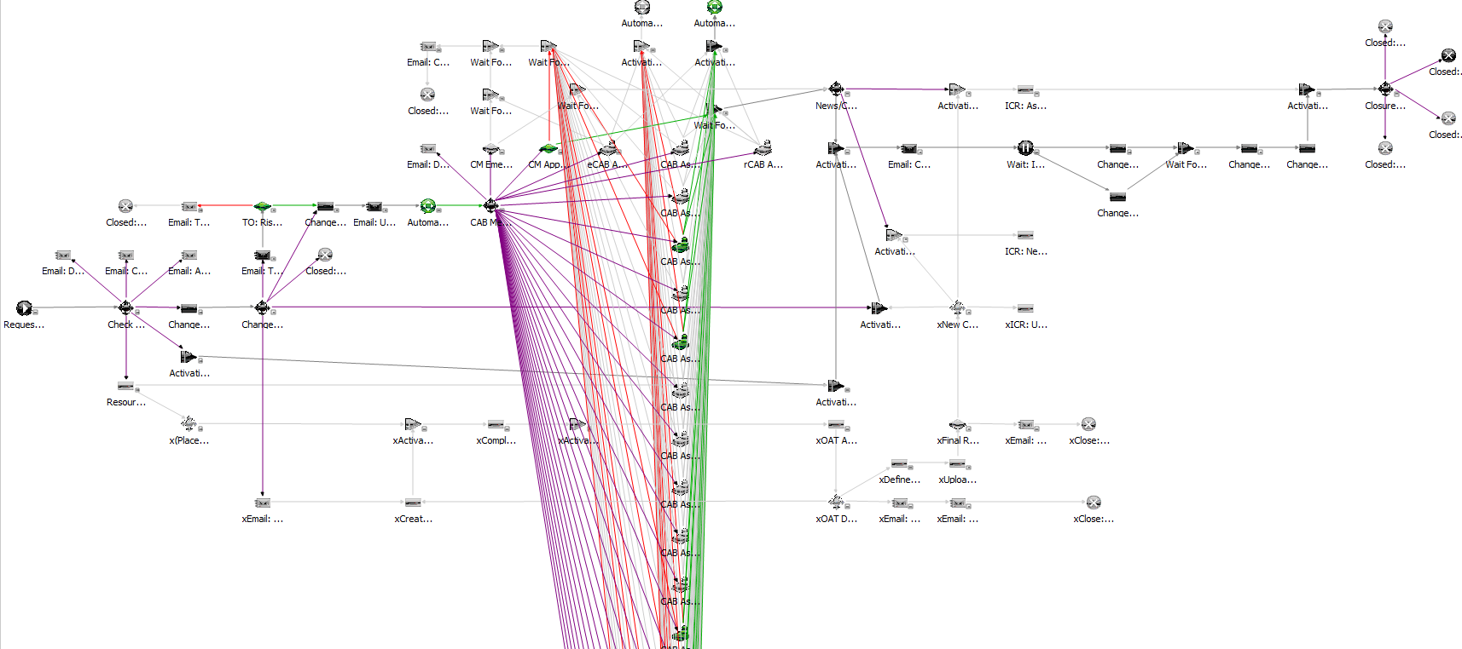
Infrastructure Change Workflow

Slide 26


30%
Reduction in calls to the ICT Service Desk over 3 Months

Slide 27
Recent and Future Developments
Procurement workflows.
Corporate Procurement Hub.
Corporate Finance.
Internal (ICT) approvals.
Adults and Children’s Services.
ICT Catalogue.
PowerShell scripting for 100% self service.
SNOW Integration – license validation

Slide 28
Recent and Future Developments
Automatic provision of VDI for new users.
New webpage to view Request approvals and department approvers.
Automated Password Reset using PowerShell.
Updated FTR form to improve call analysis.
Stock Control - ICT Equipment Check/Order.
Work From Home Calendar.
Enhanced management reports.

Slide 29
Demonstration: Alemba Service Manager
Chris Forster, Pre-Sales Engineer, Alemba

Slide 30
Other Departmental Use Cases
Clark Stalham, VP of Projects, Alemba

Slide 31
Greater Manchester Police
GMP needed a flexible tool to help:
Automate their systems administration workflows
Consolidate disparate data sources in a single, federated CMDB
Offer a user-friendly self-service interface for users to log tickets and request services

Slide 32
GMP: Automating critical processes
GMP have 151 active workflows
Examples:
Password reset script – Allows users to reset their colleague’s Windows passwords, 24/7 without the need for intervention from the IT department.
System reboot PowerShell – Automated System Reboot through ASM – all without the need for server access.
Active Directory PowerShell – Allows users to change the network drives they can access. This process is logged as a request in Alemba Service Manager and then triggers an approval task.

Slide 33
GMP: Outcomes
151 automation workflows have been implemented.
24 345 password reset workflows have been run – an average of 900 per month.
4500 Active Directory workflows have been run. At a conservative estimate of 5 minutes to perform this task manually, the department saw an estimated time-saving of 375 hours.

Slide 34
Haringey Council Shared Service Centre
Haringey required a solution which would combine multiple business functions in to a single front office entity
A single point of entry for all business issues and requests from its user base of 2000+ staff
A common user experience through Self Service functionality
Automation of request fulfilment
KPI reporting across services

Slide 35
Haringey Council
IT, HR, Procurement, Finance & Revenue & Benefits functions brought in to a single system
A single service desk introduced with one telephone number, one email and a unified approach to the dealing of user issues and queries
A single self service portal for all business requirements

Slide 36
Haringey Council: The Benefits
Improved customer satisfaction
Reduced TCO by consolidation of systems
Automation of key business processes (Employee onboarding)
Integration with other systems e.g Guest wireless password initiation and deployment

Slide 37
Counter-Fraud and Probity Services (HSCNI)
Full lifecycle and complex case management with very strict governance and security/confidentiality aspects.
The BSO's Operations Directorate is home to the regional Counter Fraud and Probity Services (CFPS), which provides a criminal investigation service to all NHS bodies in Northern Ireland. This service is delivered by a team of accredited counter fraud specialists, which in December 2010 almost doubled in size, reflecting increased commitment to counter fraud activities.

Slide 38
Counter-Fraud and Probity Services (HSCNI)
The proposed Counter Fraud System was required to deal with two key requirements:
Provide remote access for HSC bodies to a secure central system for the mandatory reporting of cases of suspected fraud for onward transmission to “Oversight Bodies”; and
provide a secure ring-fenced fraud case management system, which would deliver a comprehensive evidential record and audit trail for all aspects of individual investigations.

Slide 39
Counter-Fraud and Probity Services (HSCNI)
The CFPS implemented ASM and deployed a customer portal allowing Fraud Liaison Officers (FLOs) from all HSC organisations to submit cases of suspected, actual or attempted fraud electronically and worked closely with the:
Reporting Team to develop new arrangements to satisfy statutory reporting requirements;
Investigations Team to develop a new set of processes in support of case management.

Slide 40
Questions?

